Slide 1
Old Photos Colorization Using CNNs and DNN
Yaqiu Liu,
Wudi Zheng,
Haoran Ding

Slide 2
Topic
Related Works
Advantages
Model Architecture
Innovation
Training Method

Slide 3
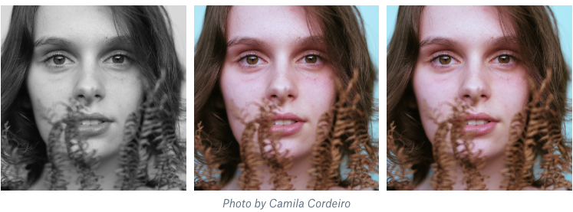
1. Topic:
Our topic is coloring the old photos with Neural Networks:
Grey Scale Input
Real Photo
Output Photo
Coloring Result

Slide 4
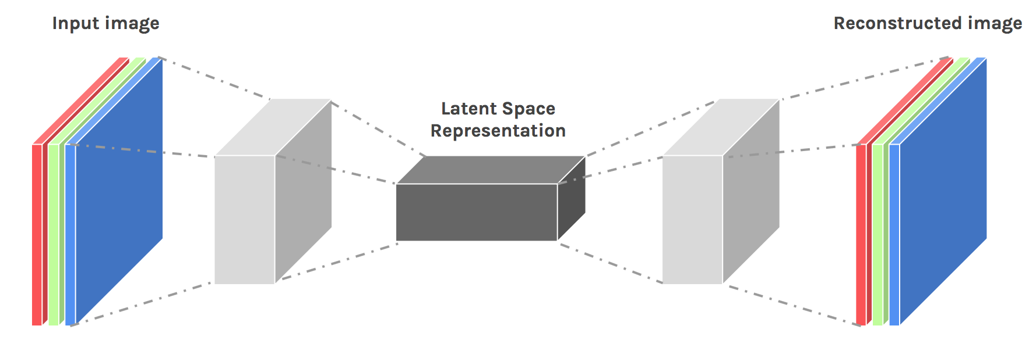
1. Topic:
The Neural Networks we choose is an encoder-decoder architecture:
An Overview of the Model Architecture

Slide 5
2. Related Works:
Existing colorization algorithms mainly consist of 3 categories:
Scribble-based approach
Reference-based approach
Fully automatic approach

Slide 6
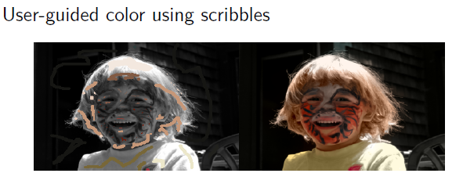
2. Related Works:
Scribble-based method:
Scribble-based Method

Slide 7
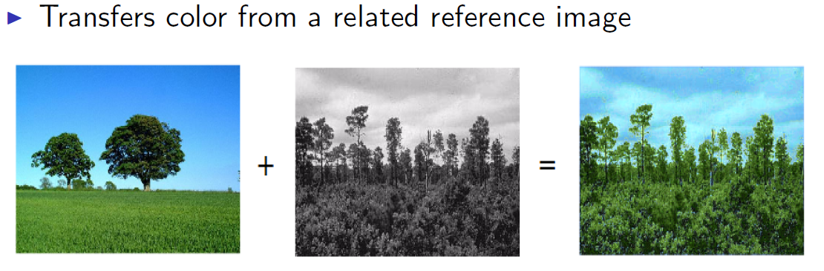
2. Related Works:
Reference-based method:
Referenced-based Method

Slide 8
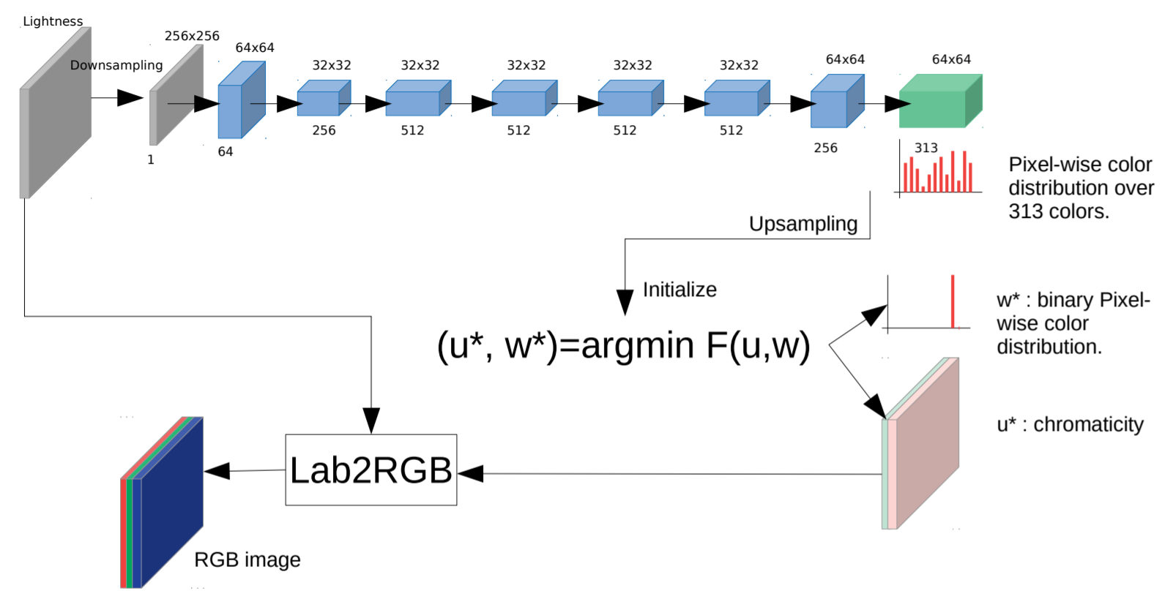
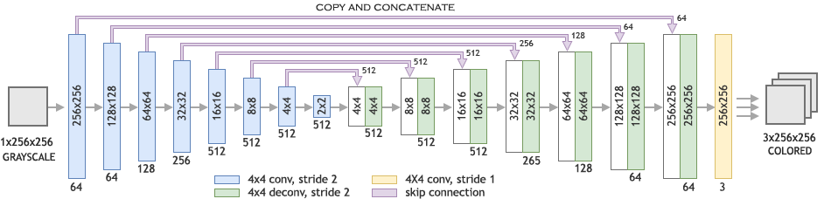
2. Related Works:
Fully automatic approach:
CNN-based model
GAN-based model
Encoder-decoder model

Slide 9
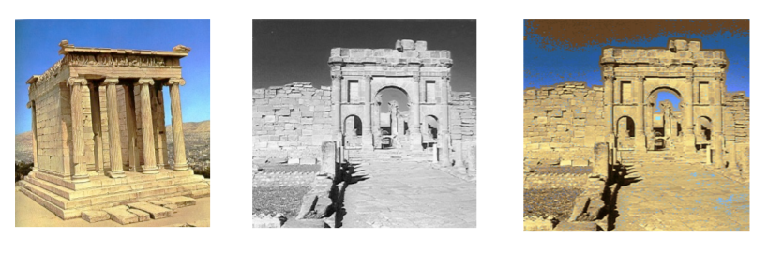
3. Advantages:
Comparing to the reference based approach, our approach can get a higher accuracy.
Referenced based Result

Slide 10
3. Advantages:
GAN based approach has some training problems like non-convergence, collapse problem.
Comparing to GAN based approach, our approach is more easier to train and we can utilize some high-level feature extraction using a pre-trained model to enhance the coloring process.

Slide 11
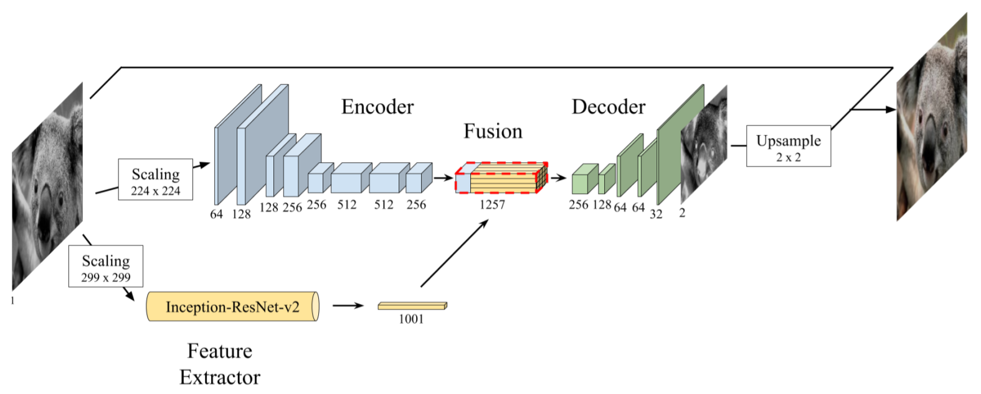
4. Model Architecture:
Baseline model:
Model Architecture

Slide 12
5. Innovation – The First Try:
We will choose different feature extractor neural network.
We will design a new encoder-decoder architecture in order to get a better performance.
We will try to implement an image pre-processing on the input image.

Slide 13
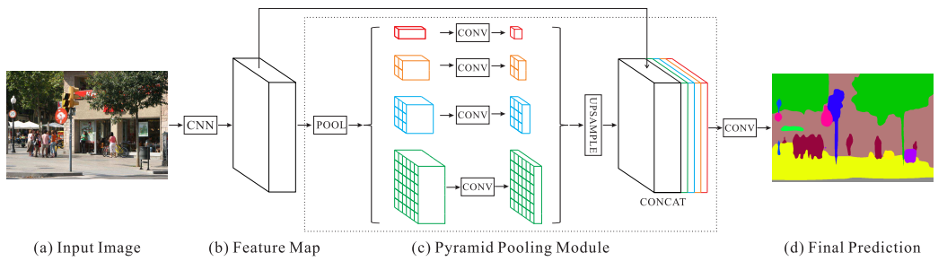
6. Innovation – Another Try:
Modify the network to a Pyramid-like Network
Inspired by PSPNet
PSPNet

Slide 14
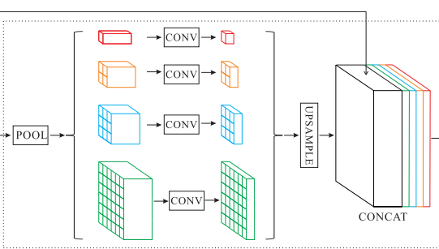
6. Innovation – Another Try:
New network
(maybe)
Original encoder
Original image
with
Overlay-tile Strategy
Fusion layer
Decoder
(exclude the last layer)
Pyramid pooling module
Output
Feature extractor

Slide 15
7. Training Approach:
Data source: ImageNet, Pascal VOC
Training method:
Train the net by reducing the Mean Square Error between the estimated pixel colors and their real value.
Test approach:
MSE
Real-perception

Slide 16
The END
Thank You!

